Slide 1
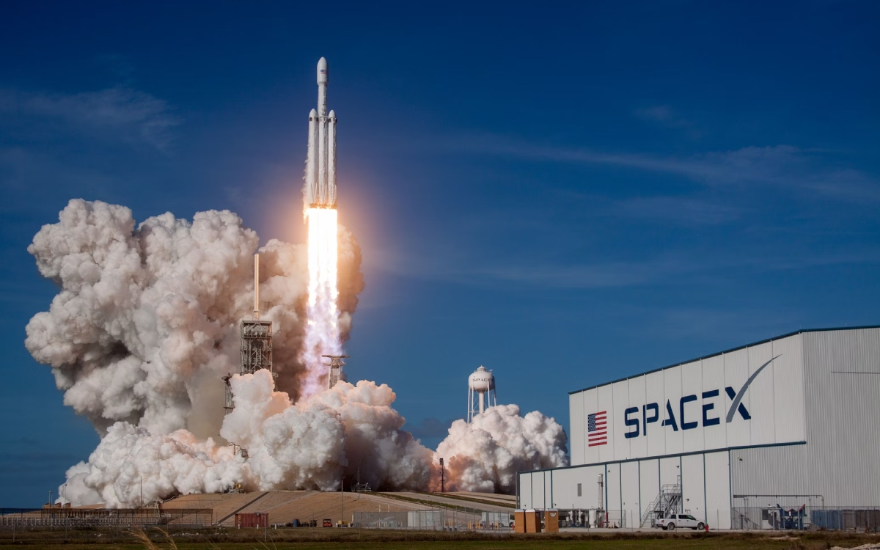

Applied Data Science Capstone Project
Fábio Clemente Vilela
07/12/2024

Slide 2
Executive Summary
SpaceX, the most successful company in the commercial space age, has revolutionized space travel by significantly reducing costs. While other providers charge upwards of $165 million per launch, SpaceX offers Falcon 9 rocket launches for $62 million. This cost efficiency is primarily due to the reusable first stage of the Falcon 9 rockets.
This project aims to predict the likelihood of the Falcon 9 first stage landing successfully and being reused. Leveraging public information and machine learning models, this analysis will provide valuable insights for cost estimation and strategic planning for space missions. The outcome will support SpaceX's mission to make space travel more affordable and benefit the broader commercial space industry.

Slide 3
Table of Contents
Introduction
Methodology
Results
Conclusion
Appendix

Slide 4
Introduction
SpaceX has emerged as a leader in the commercial space industry by making space travel more affordable. By reusing the first stage of its Falcon 9 rockets, SpaceX can offer launches at $62 million, significantly lower than the $165 million charged by other providers. Predicting whether the first stage will successfully land and be reused is crucial for determining the cost-effectiveness of each launch.
This project uses public information and machine learning models to predict the likelihood of the Falcon 9 first-stage landing successfully. The analysis aims to answer the following questions:
How do variables such as payload mass, launch site, number of flights, and orbits affect the success of the first stage landing?
Does the rate of successful landings increase over the years?
What is the best algorithm for binary classification in this case?

Slide 5
Methodology
To achieve these goals, the following steps will be undertaken:
Data Collection: Gathering data on Falcon 9 launches using SpaceX Rest API and web scraping.
Data Wrangling: Cleaning and preparing the data for analysis.
Exploratory Data Analysis (EDA): Analyzing the data to identify patterns and relationships.
Data Visualization: Creating interactive dashboards to visualize launch records and landing success.
Model Development: Developing machine learning models including Support Vector Machines (SVM), Decision Tree Classifiers, and K-Nearest Neighbors (k-NN).
Model Evaluation: Evaluating the performance of the models to determine the best one for predicting landing success.
Reporting: Compiling the findings into a comprehensive report for stakeholders.

Slide 6

Data Collection – API
In order to collect the Data, we used two sources: SpaceX API
Decode the .json() file to a Dataframe using .json_normalize()
Request information about launches using functions
Create dictionaries from the data gathered
Make a Dataframe from the Dictionaries
Filter only Falcon 9 launches
Replace the missing Payload Mass with the calculated .mean()
Export the data to a .csv file
Github Link: Data Collection - API

Slide 7

Data Collection – Web Scraping
Request Falcon 9 Data from Wikipedia using Web Scraping
Create a BeautifulSoup object from the HTML response
Extract column names using HTML table header
Collect the Data parsing through HTML table tags
Create a dictionary from the data collected
Create a Dataframe using the dictionary
Export the data to a .csv file
Github Link: Data Collection – Web Scraping

Slide 8

Data Wrangling
Perform Exploratory Data Analysis and determine data labels
Calculate the number of Falcon 9 Launches on each site
Calculate the number of occurences on each orbit
Calculate the number of mission outcomes on each orbit type
Convert the landing outcome into binary
Export the Dataset to a .csv file
Github Link: Data Wrangling

Slide 9
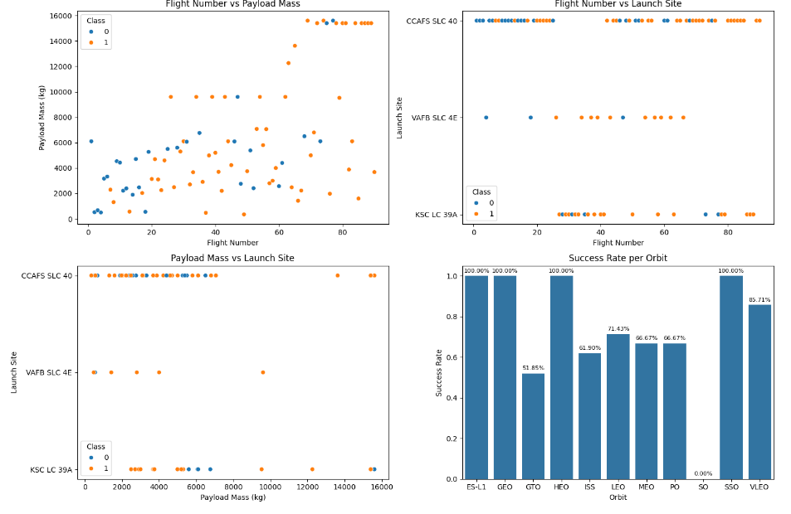
Data Visualization
Charts Plotted:
Flight Number vs. Payload Mass(kg)
Flight Number vs. Launch Site
Payload Mass(kg) vs. Launch Site
Payload Mass(kg) vs. Orbit Type
Success Rate Yearly Trend
Scatter plots are used to see relationships between variables
Bar charts are used to compare discrete and categorical variables
Line charts are used to view time series trends
Github Link: EDA – Data Visualization

Slide 10
SQL
Queries:
The name of unique launch sites
5 first records of launch sites beginning with “CCA”
Total Payload Mass carried by boosters launched by Nasa (CRS)
Average Payload Mass carried by Falcon 9 v1.1 booster
Date when the First Booster landed successfully on a ground pad
List of boosters that successfully landed in drone ship and have a payload mass between 4.000 and 6.000 kg
List of total number of failures and successful mission outcomes
List of names of the booster versions which have carried the maximum payload mass
List of failed landing outcomes in drone ships, their booster versions and launch site names for the months in the year 2015
Count of landing outcomes between 2010-06-04 and 2017-03-20 (desc)
Github Link: SQL

Slide 11
Interactive Map - Folium
Lanch sites markers:
Added markers with a circle, popup label, and text label of all launch sites using their latitude and longitude coordinates to show their geographical locations
Colored markers based on the outcomes:
Added Green markers for successful launches and Red for failed launches using Marker Clusters to show success rates
Distance to its proximities:
Added additional lines and markers to show the launch site proximities with railroads, highways, coastline, and nearest city
Github Link: Interactive Map - Folium

Slide 12
Dashboard with Plotly Dash
Drowpdown Launch Sites list:
The user can select a specific launch site
Pie Chart showing successful launches:
Allows the user to see the percentage of suceesses and failures of all or specific launches
Slider of Payload Mass range:
Allows the user to choose a specific Payload Mass range
Scatter Chart of the Payload Mass vs Success Rate by Booster Version
Allows the user to see the correlation between Payload Mass and Launch Success
Github Link: Dashboard with Plotly Dash

Slide 13

Predictive Analysis
Github Link: Predictive Analysis

Slide 14
Results

Slide 15
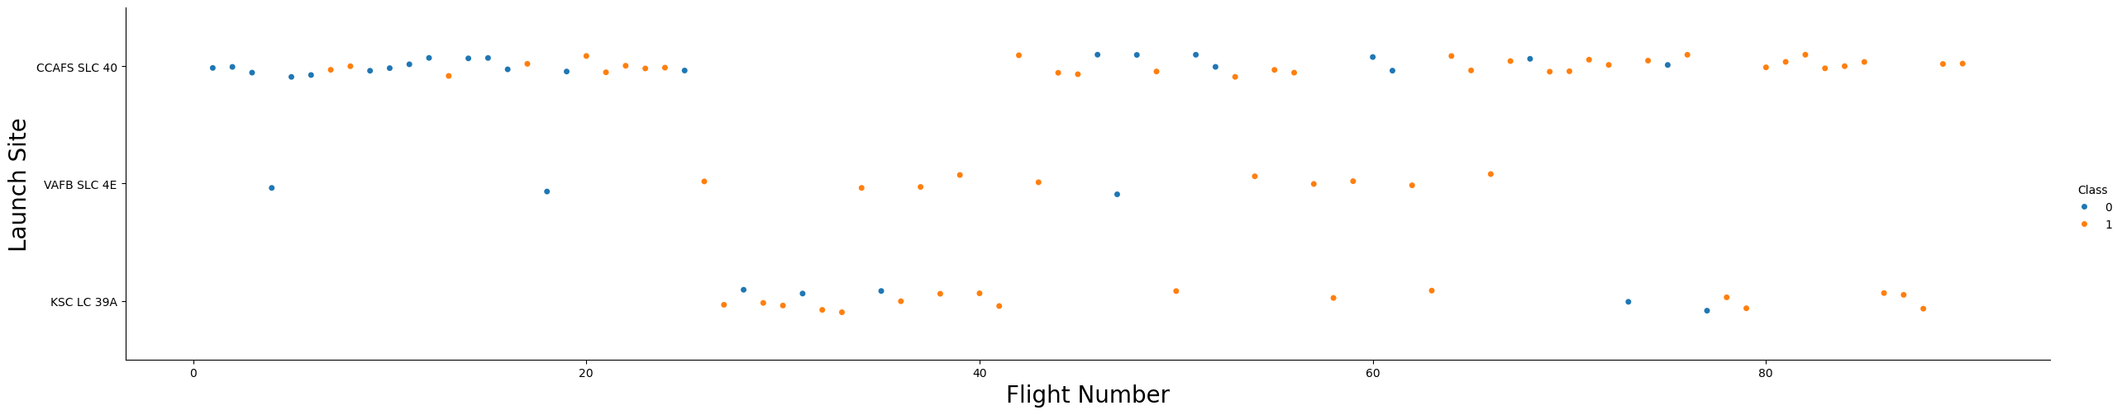
Exploratory Data Analysis
The Falcon 9 rockets were launched on 3 Sites:
Cape Canaveral Air Force Station - Space Launch Complex (CCAFS SLC-40)
Vandenberg Air Force Base - Space Launch Complex (VAFB SLC 4E)
Kennedy Space Center - Launch Complex (KSC LC 39A)
Around Half of the launches were from the CCAFS SLC 40 launch site
Early flights have a higher fail rate (Blue)
Later flights have a higher success rate (Orange)
Based on the analysis, it’s safe to infer that new launches have a higher chance of success

Slide 16
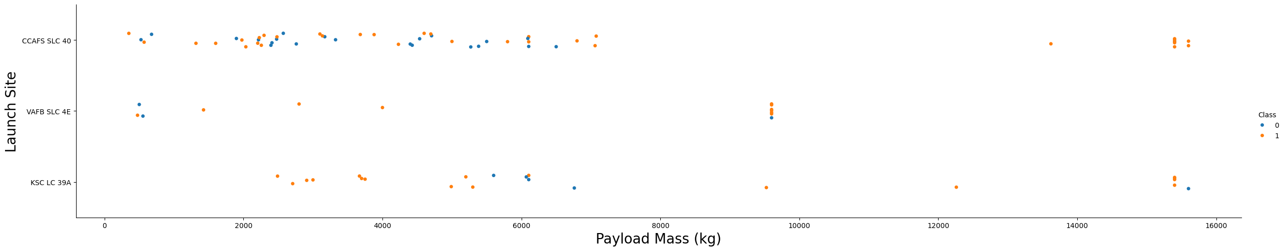
Exploratory Data Analysis
We can say that, the higher the Payload Mass(kg), the higher the success rate
Payload Masses of 7.000 kg or higher have a higher success rate
On KSC LC 39, all lanches lower than 5.500 kg were successful
VAFB SLC 4E hadn’t launched any rockets greater than 10.000 kg

Slide 17
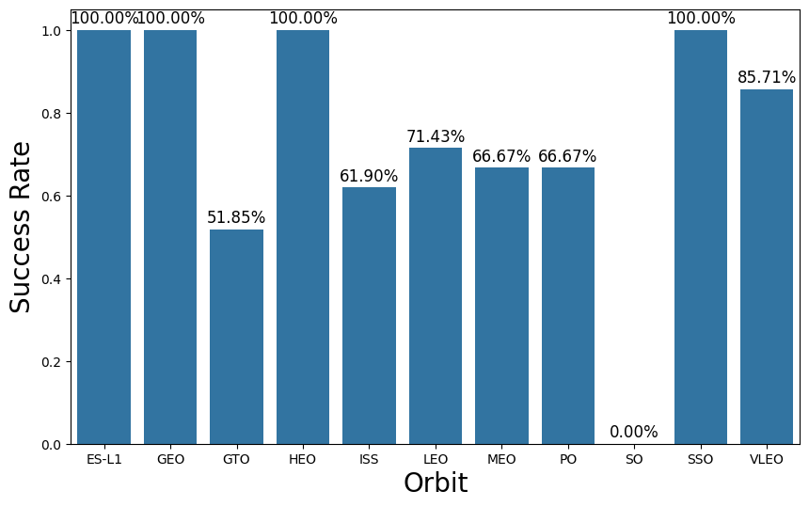
Exploratory Data Analysis
Relationship between each Orbit type:
ES-L1, GEO, HEO, and SSO had a 100% Success Rate
GTO, ISS, LEO, MEO, and VLEO had between 51.85 to 85.71% Success Rate
SO had a 0% Success Rate

Slide 18
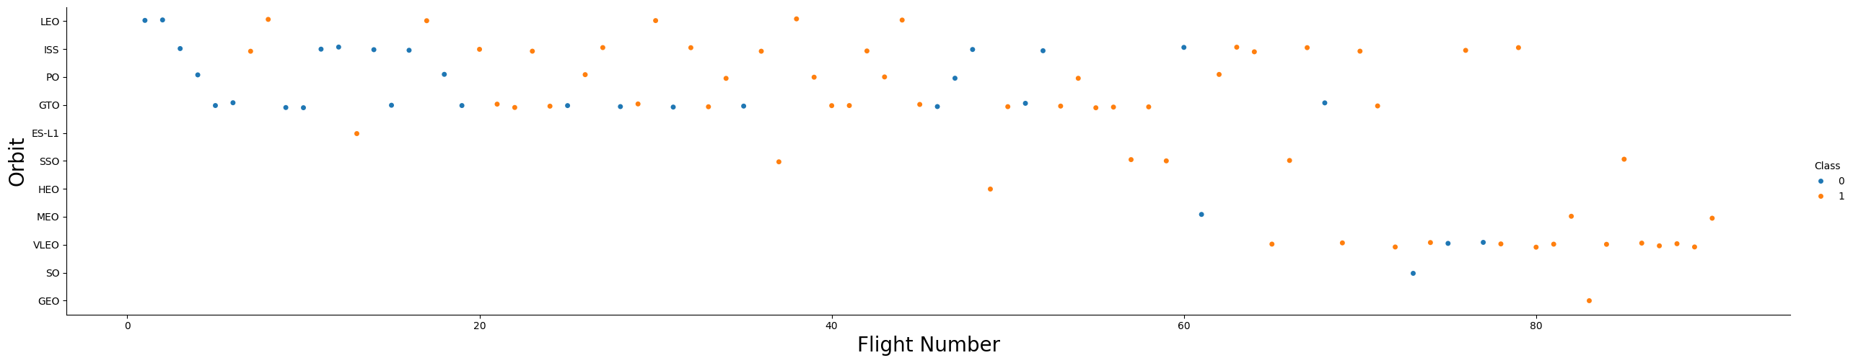
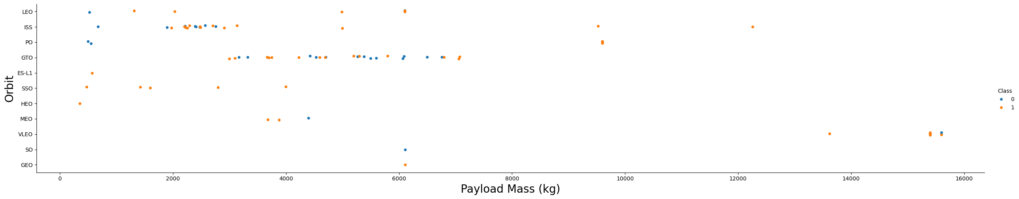
Exploratory Data Analysis
There is the trend of success increase with each orbit type as the number of flights increase
However, the GTO orbit doesn’t follow this trend
Heavier Payload Mass had more success with LEO, ISS, and PO Orbits
However, GTO had mixed results

Slide 19
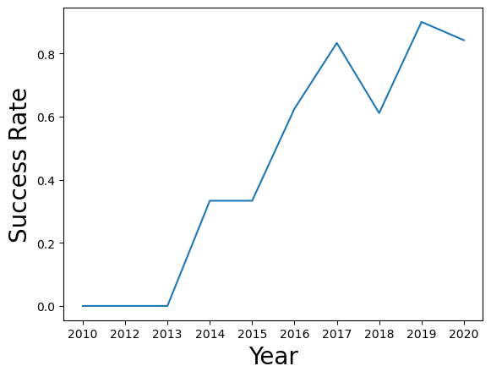
Exploratory Data Analysis
The yearly success was increased from 2013 to 2017 and from 2018 to 2019
However, it had some decrease in the years 2013 and 2020
Overall, we can say that the Success Rate increased throughout the years

Slide 20
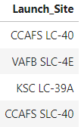
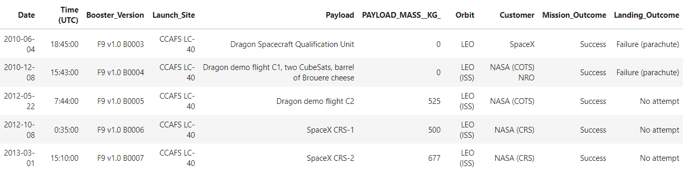
Exploratory Data Analysis - SQL
There are four launching sites in the dataset, although Falcon 9 was launched from only 3 of them
Records with the first 5 Launch Sites records started with “CCA”:

Slide 21
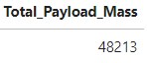
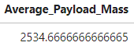
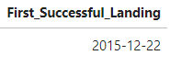
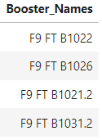
Exploratory Data Analysis - SQL
The Total Payload Mass carried by boosters launched by NASA(CRS) was 48.213 kg
The Average Payload Mass carried by Falcon 9 v1.1 was around 2.534,66 kg
The First Successful Lnading was on December 22, 2015
The name of the boosters that landed on a drone ship that has a payload between
4.000 and 6.000 kg was

Slide 22
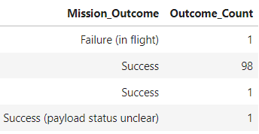
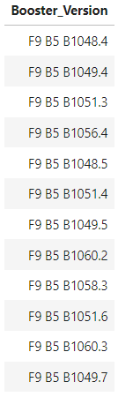
Exploratory Data Analysis - SQL
Total number of successful and failed mission outcomes
Boosters that carried the maximum payload

Slide 23
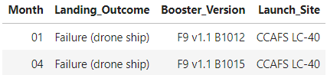
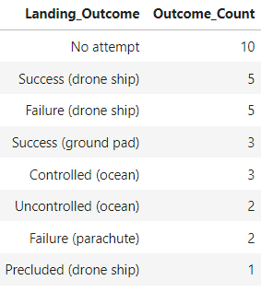
Exploratory Data Analysis - SQL
Boosters that Failed landing on drone ship in the months of 2015
Count of landing outcomes from 2010-06-04 to 2017-03-20 in descending order

Slide 24
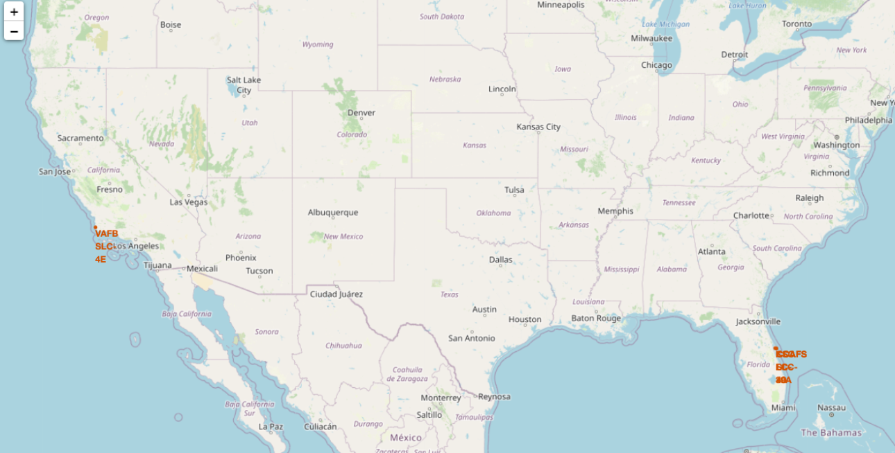
Interactive Map with Folium
All launch sites are close to the coastlines, as launches
towards the ocean to minimize the risk of debris dropping
or exploding near residential areas.
Many launch sites are situated close to the Equator.
This is because the Earth's rotation is fastest at the
Equator, with surface speeds reaching 1.670 km/hour.
When a spacecraft is launched from this region, it ascends
into space while retaining the horizontal velocity it had due to Earth's rotation. According to Newton's first law of motion, this inertia helps the spacecraft achieve and maintain the necessary speed to stay in orbit.

Slide 25
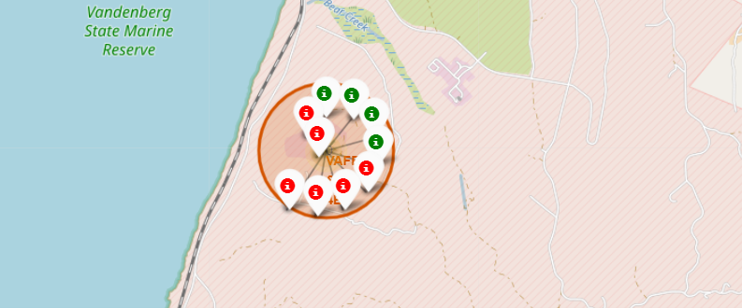
Interactive Map with Folium
Each launch was clustered with the number of launches
When the number is clicked, we can see that the Failure
are marked in Red and Success is marked in Green
By Looking at the number of launches, we can identify
the success rate

Slide 26
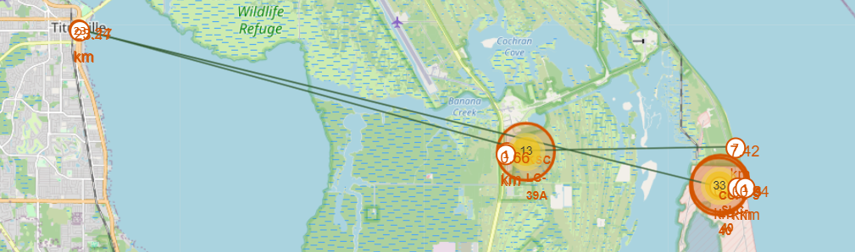
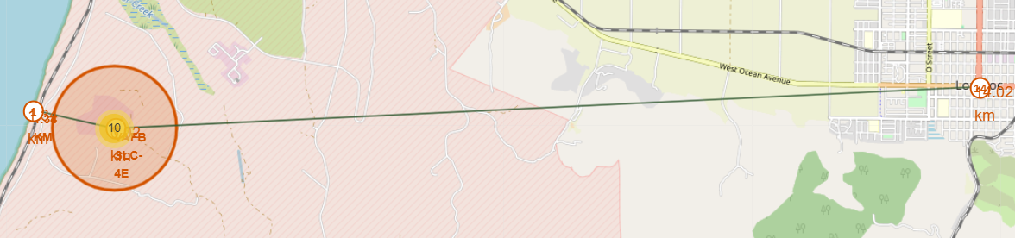
Interactive Map with Folium
KSC LC-9:
Distance from the Coastline: 7.42km
Distance from the Highway: 0.63km
Distance from the Railway: 0.66km
Distance from the Nearest City: 16.24km
CCAFS SLC-40:
Distance from the Coastline: 0.94km
Distance from the Highway: 0.66km
Distance from the Railway: 0.01km
Distance from the Nearest City: 23.17km
VAFB SLC-4E:
Distance from the Coastline: 1.34km
Distance from the Railway: 0.02km
Distance from the Nearest City: 14.02km

Slide 27
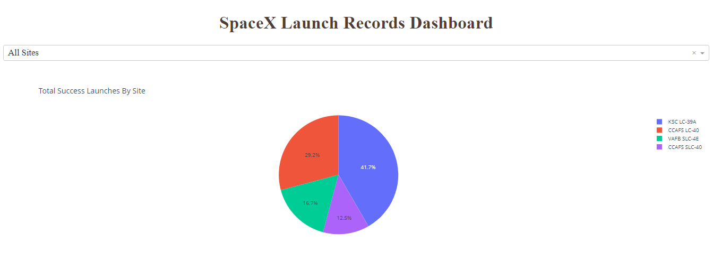
Dashboard with Plotly Dash
By Looking at the chart, we can see that KSC LC-39 has the most successful launches (41.7%)

Slide 28
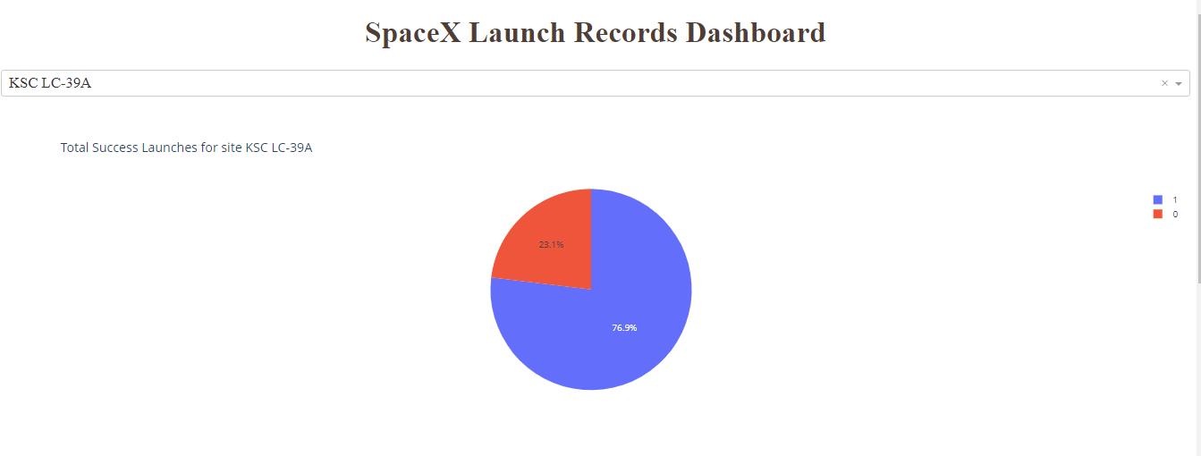
Dashboard with Plotly Dash
KSC LC-39A has the most successful launches among all launching sites (76.9%)
There are 10 successful launches and 3 failed launches.

Slide 29
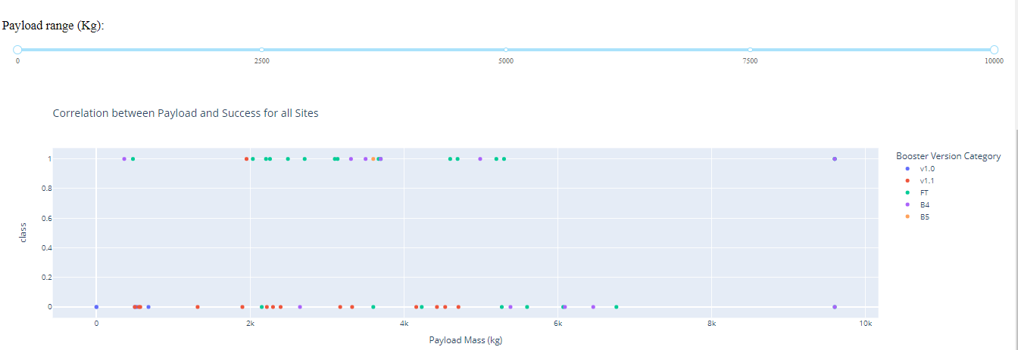
Dashboard with Plotly Dash
Payload masses between 2.000 and 5.000 kg have the highest success rates among all (0 is Failure and 1 is Success)

Slide 30
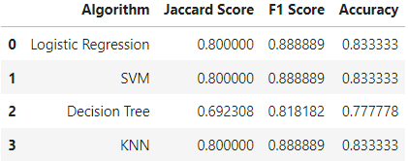
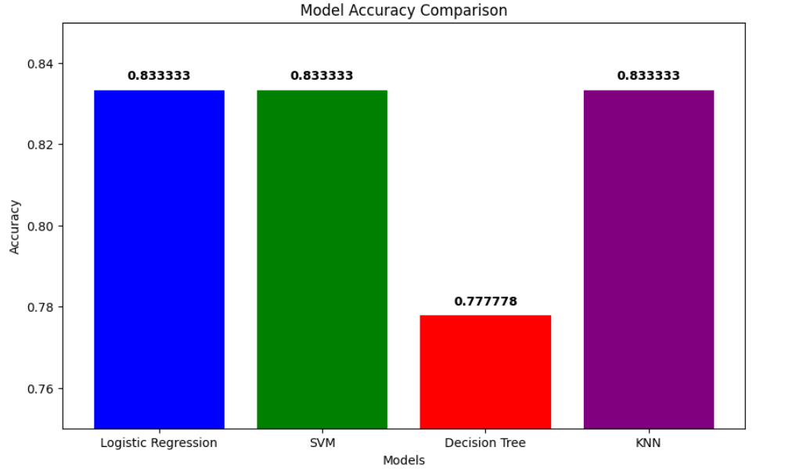
Predictive Analysis - Classification
Logistic Regression, SVM, and KNN share the highest classification accuracy
at 83.33%. The Decision Tree model has the lowest accuracy at 77.78%

Slide 31
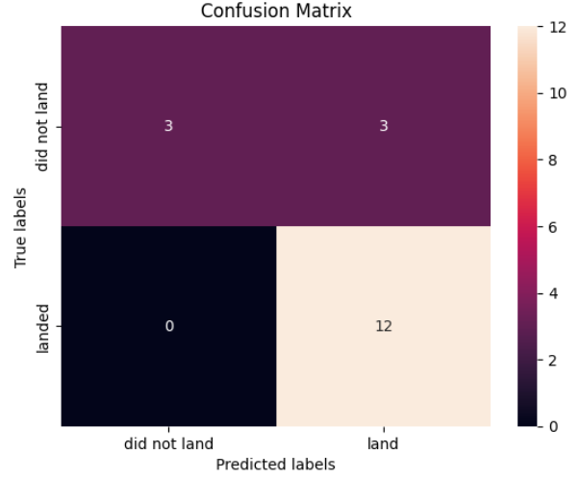
Predictive Analysis - Confusion Matrix
While Looking at the Confusion Matrix, we can see that the major
prroblem si the false positives, also know as type 1 error.
Outputs:
12 True Positives
3 True Negatives
3 False Positives
3 False Negatives

Slide 32
Conclusion
All launches are close to Coastilnes to prevent accidents. Also, mos of them near the equator line
Lanch Success increased over time.
KSC LC-39A has the highest success rates among all launching sites and has 100% success rate for launches under 5.500 kg.
The higher the payload mass, the higher the success rate.
All models have similar performance, except Decision Trees.
The small dataset might contribute to the similar model performance and false negatives. A larger dataset might help mitigate these issues.
ES-L1, GEO, HEO, and SSO have 100% success rates.

Slide 33

Appendix
Data Sources
SpaceX API Data:
URL: SpaceX API
Description: Data collected from the SpaceX REST API, including launch details, payload information, and landing outcomes.
Wikipedia Data:
URL: Wikipedia Falcon 9
Description: Data scraped from the Falcon 9 Wikipedia page, including historical launch data.
I would like to thank IBM, Coursera and all the Instructors for this series of courses.
Special thanks to my fiance who supported me throughout this journey

